Slide 1
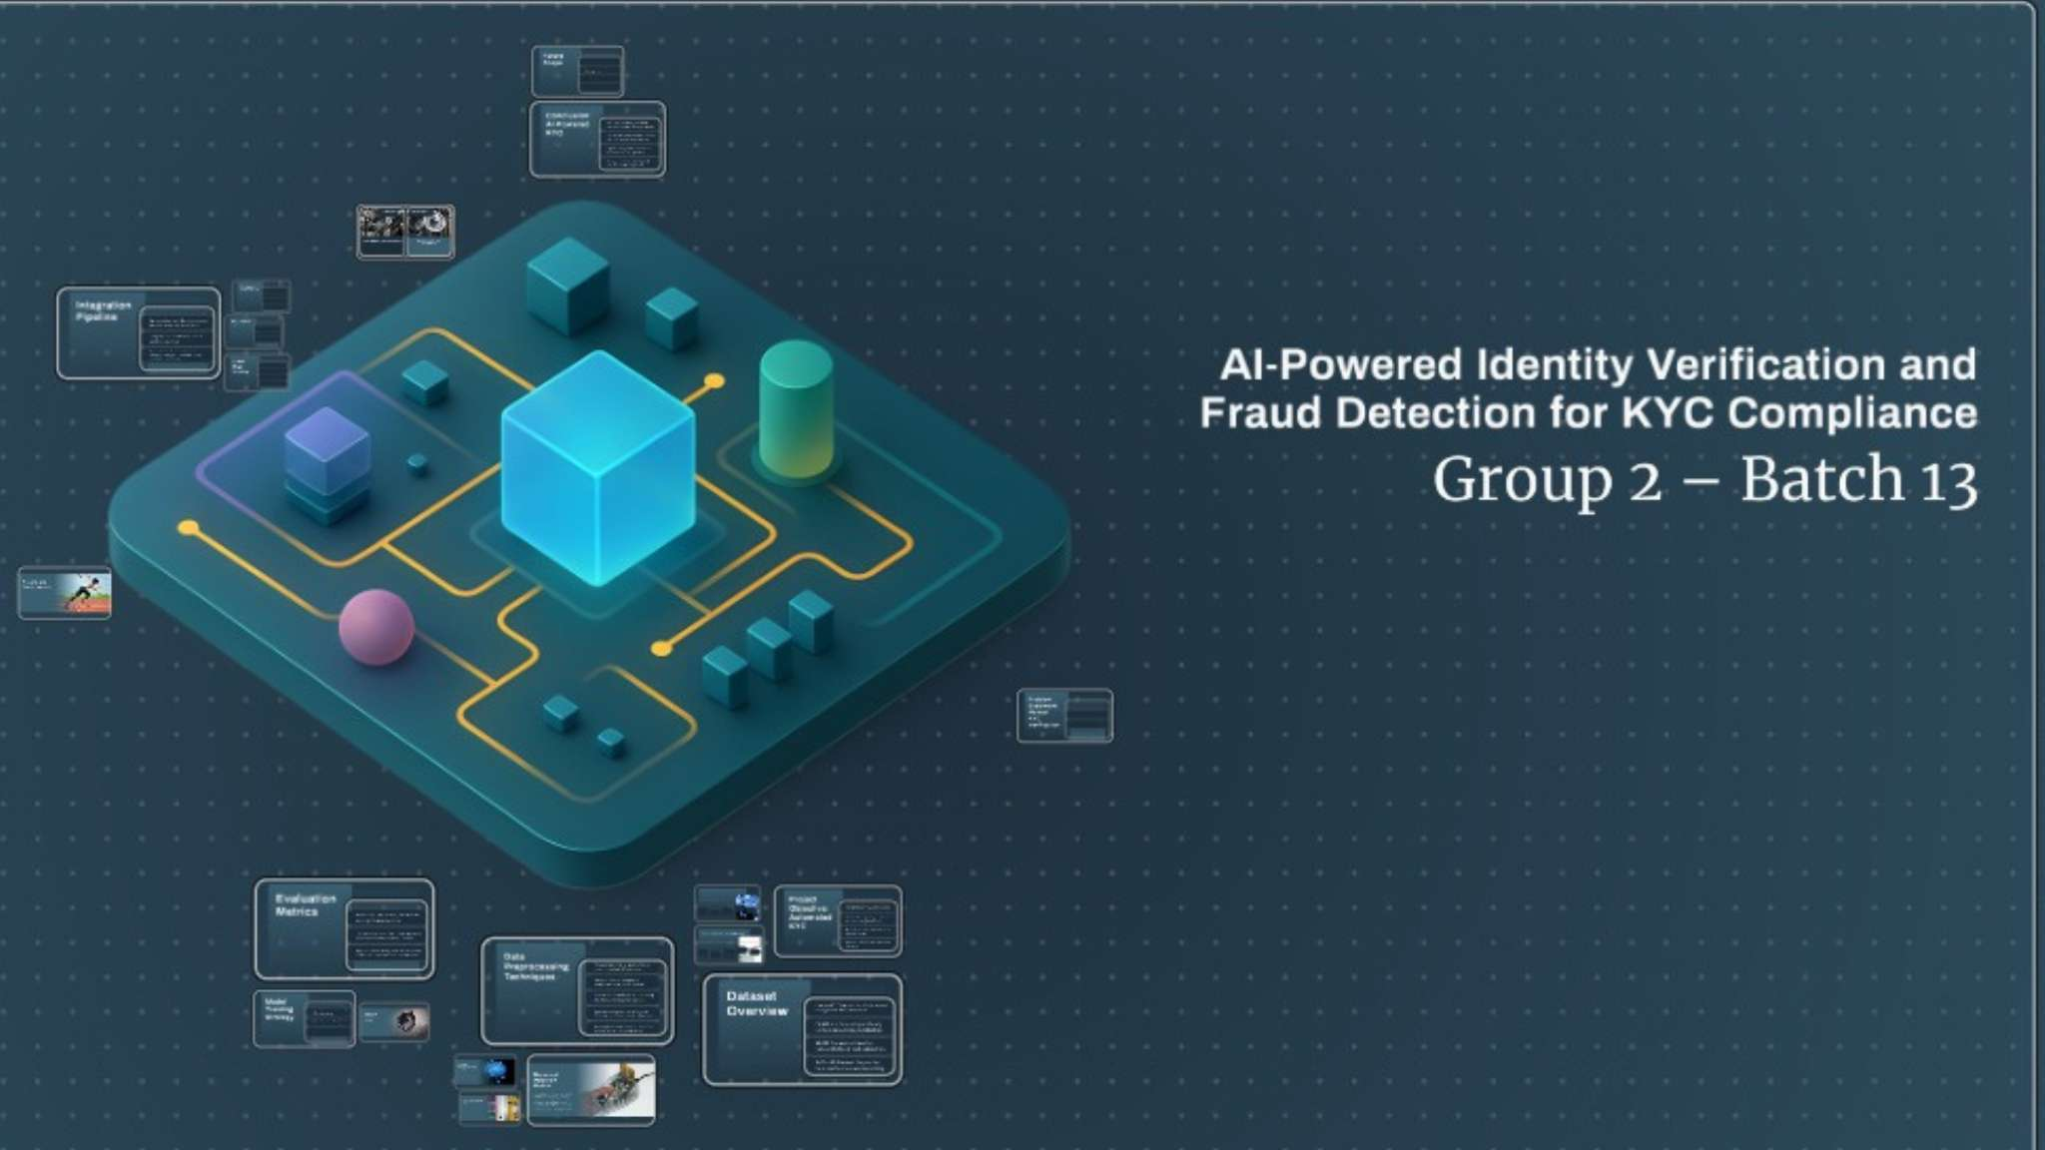

Slide 2
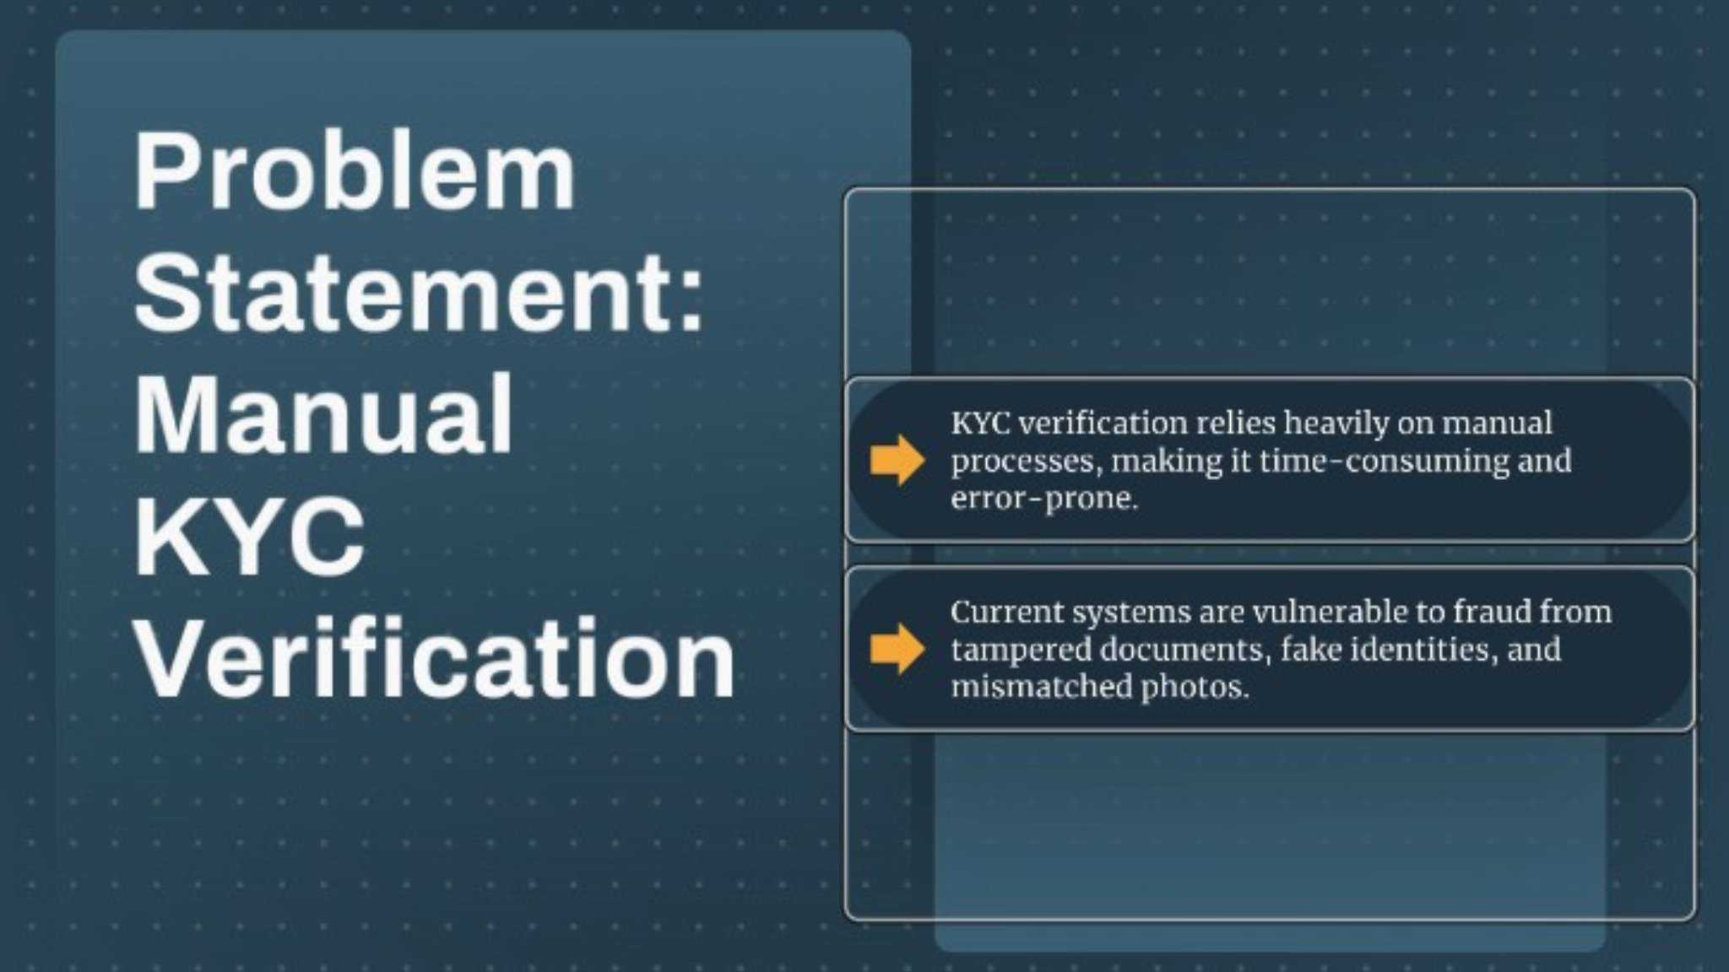

Slide 3
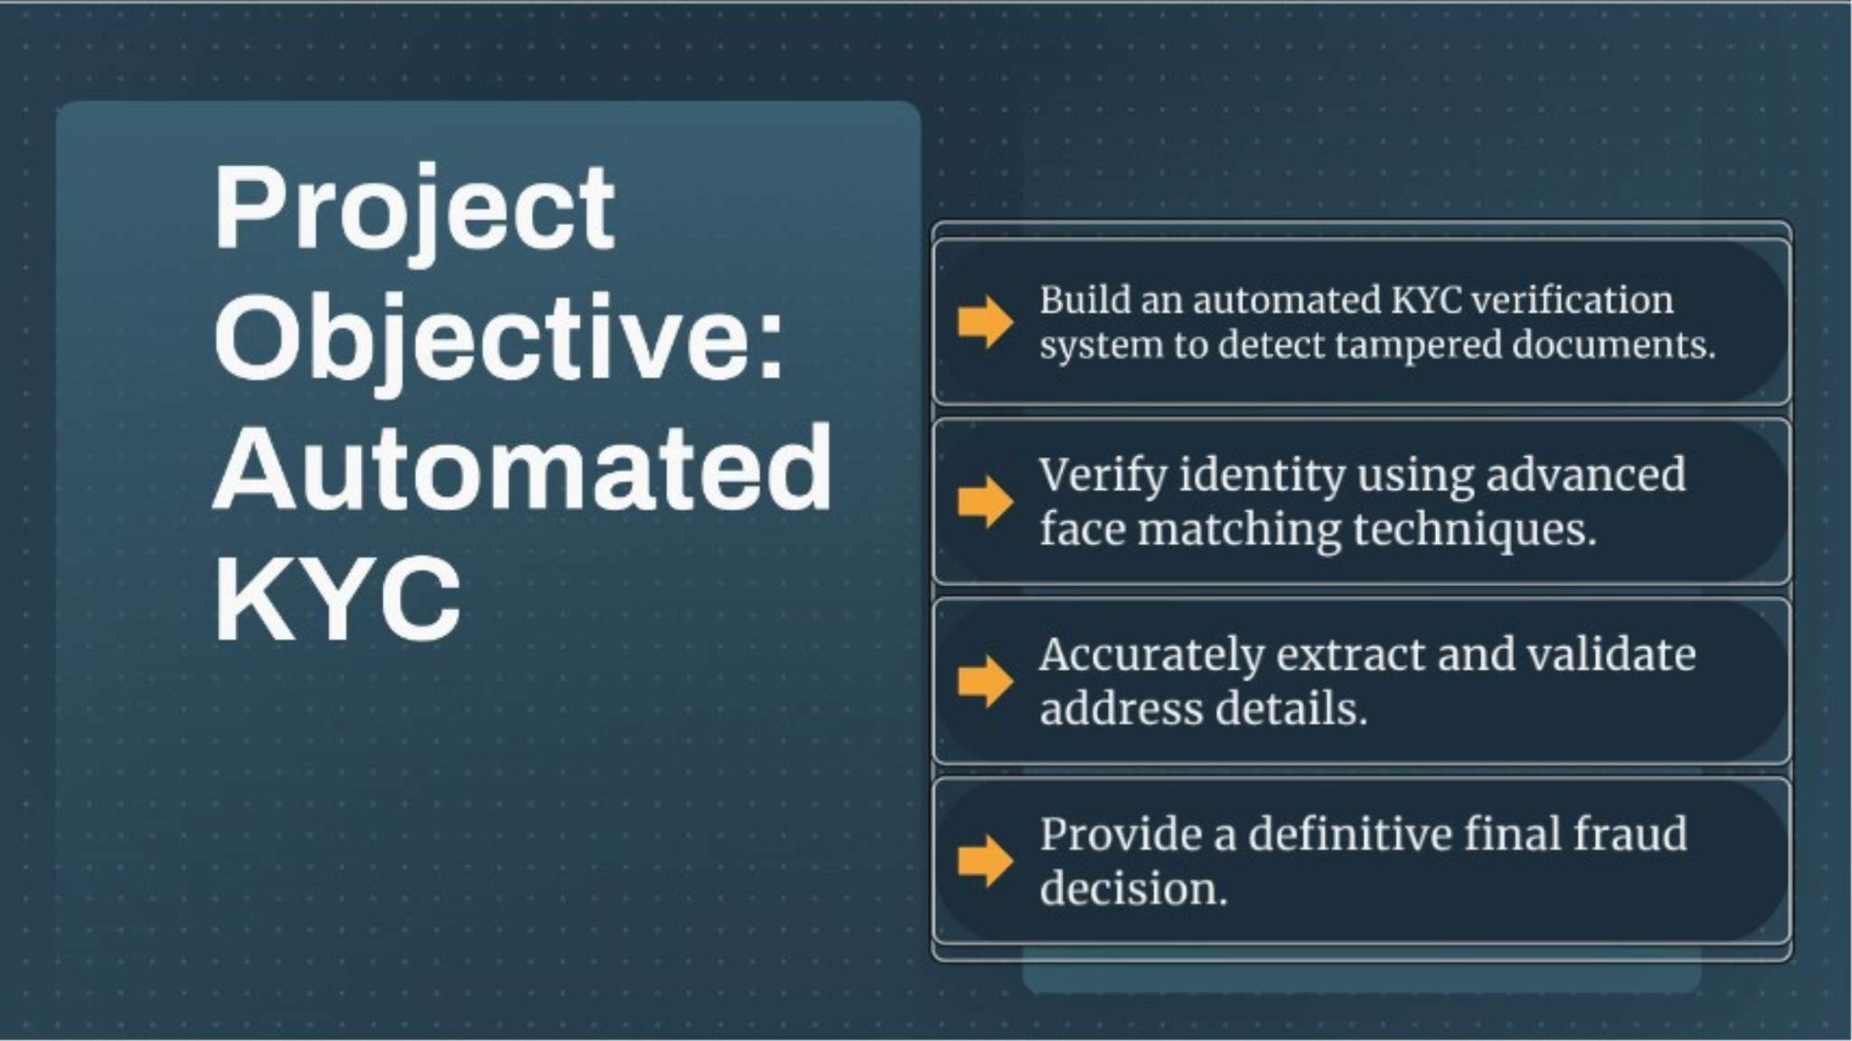

Slide 4
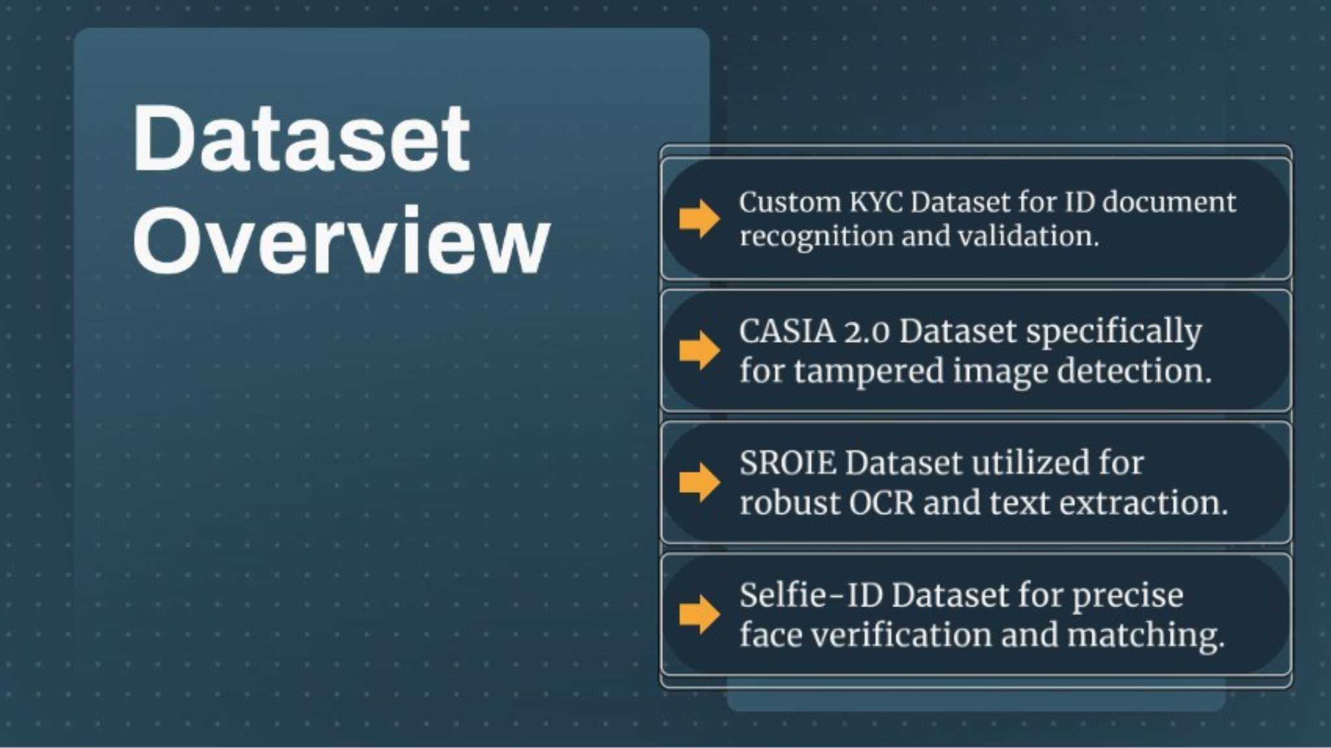

Slide 5
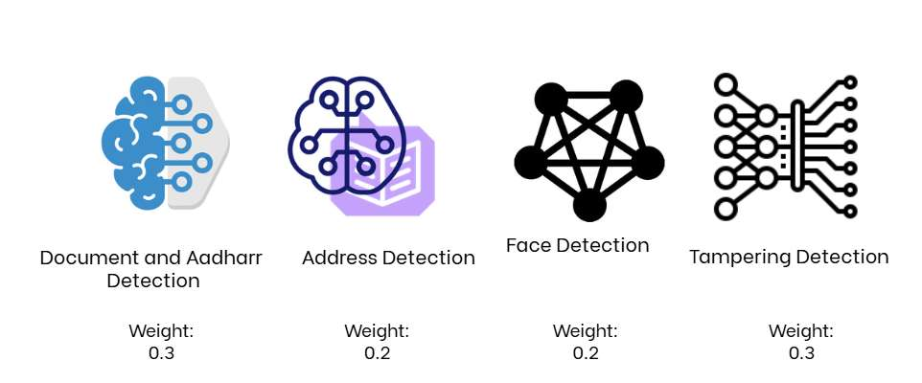

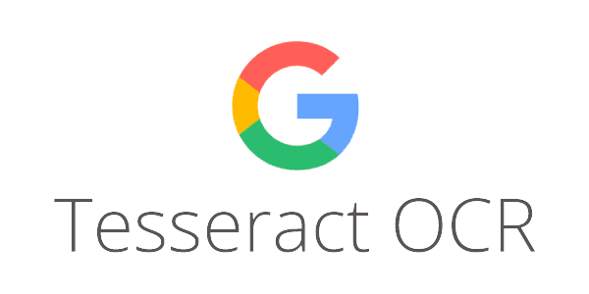



4-Layer KYC Verification System
Layer 1: Document Verification - The system first authenticates the document type (Aadhaar, utility bills, ID proofs) using image classification and document detection models. This layer ensures the document is valid and matches the expected format.
Layer 2: Face Verification - Facial recognition algorithms compare the photograph on the document with a live selfie or submitted image to verify identity match and prevent spoofing attacks.
Layer 3: Address Detection & Extraction - Object detection identifies the address region in documents, then OCR extracts the text for parsing and validation against database records and geographic databases.
Layer 4: Tampering & Fraud Detection - Advanced image forensics and anomaly detection identify document manipulation, alterations, and suspicious patterns. This layer flags potential forgeries and fraud attempts.
The system integrates Ultralytics (YOLO 8.4.21) for object detection and document localization, EasyOCR (1.7.0) and PyTesseract (0.3.13) for optical character recognition, OpenCV (4.10.0.84) for image processing and manipulation, NumPy (1.26.4) and Scikit-image (0.24.0) for numerical computations and advanced image analysis, Scikit-learn (1.5.0) for machine learning algorithms detecting anomalies and fraud patterns, Joblib (1.4.2) for model serialization, and FastAPI (0.115.0) with SQLAlchemy (2.0.23) for API orchestration and verification record management. This multi-layered approach provides comprehensive identity verification while reducing manual effort and significantly improving AML/KYC compliance accuracy.

Slide 6
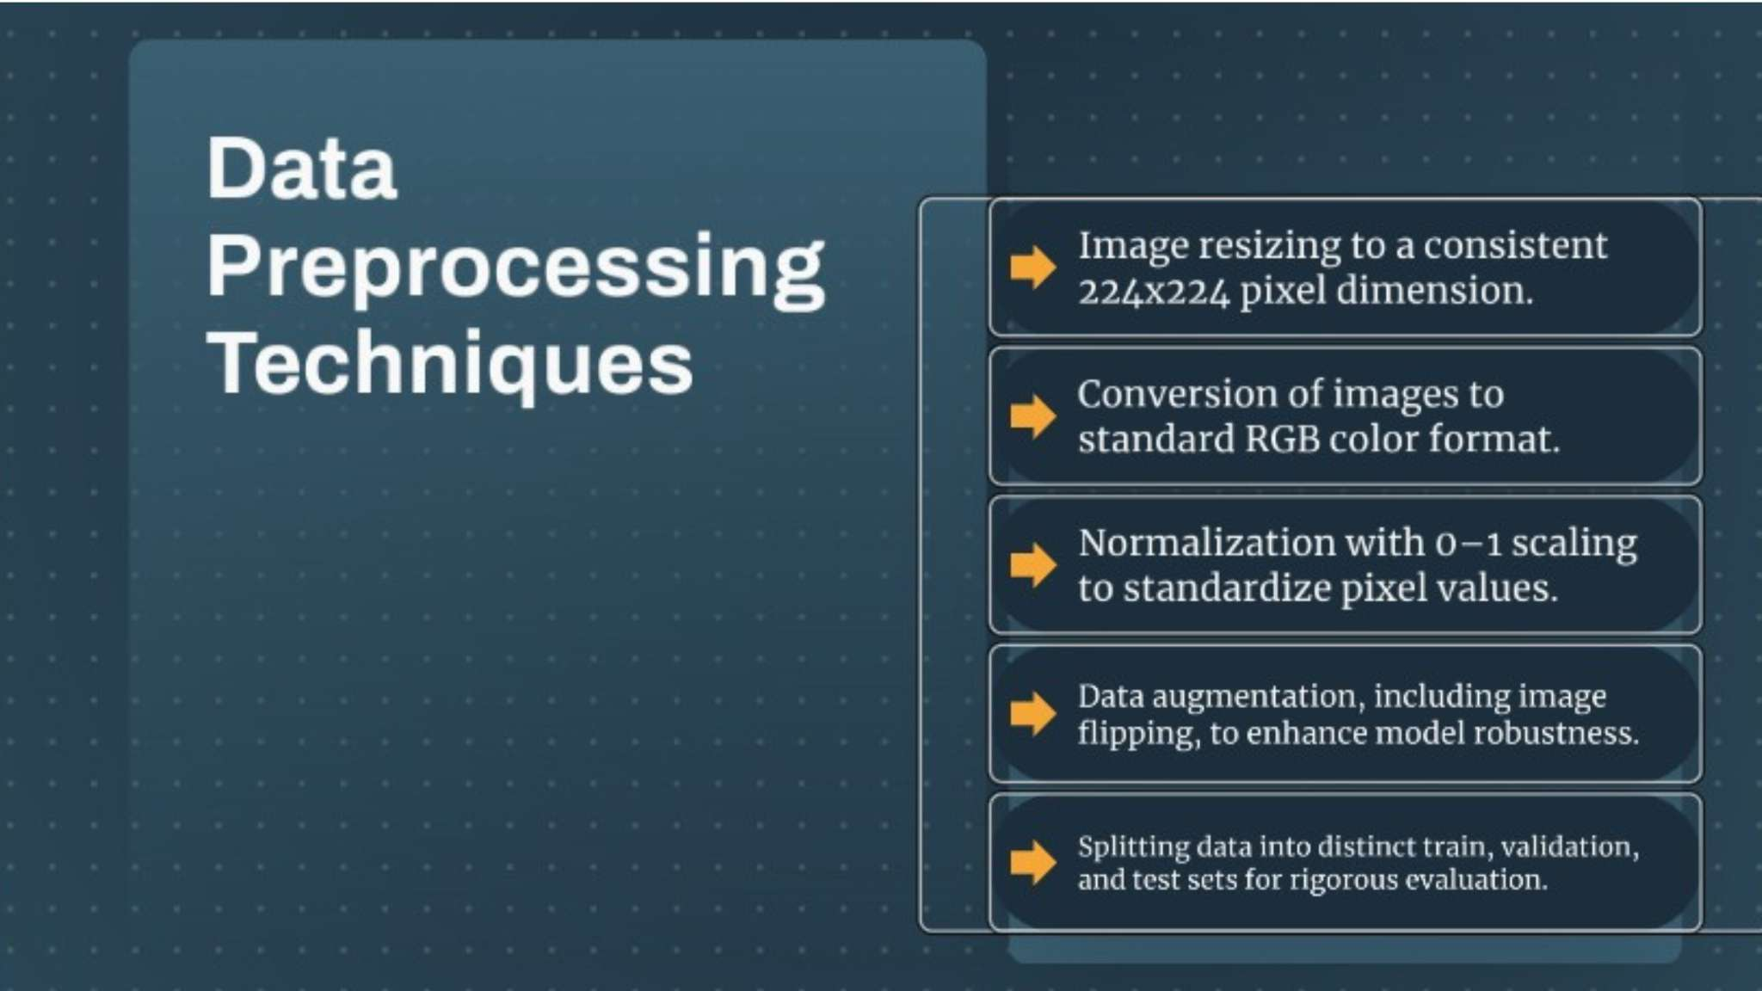

Slide 7
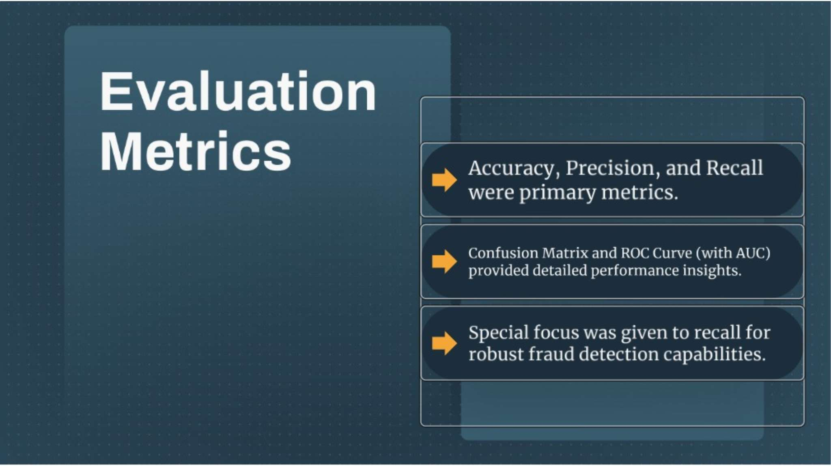

Slide 8
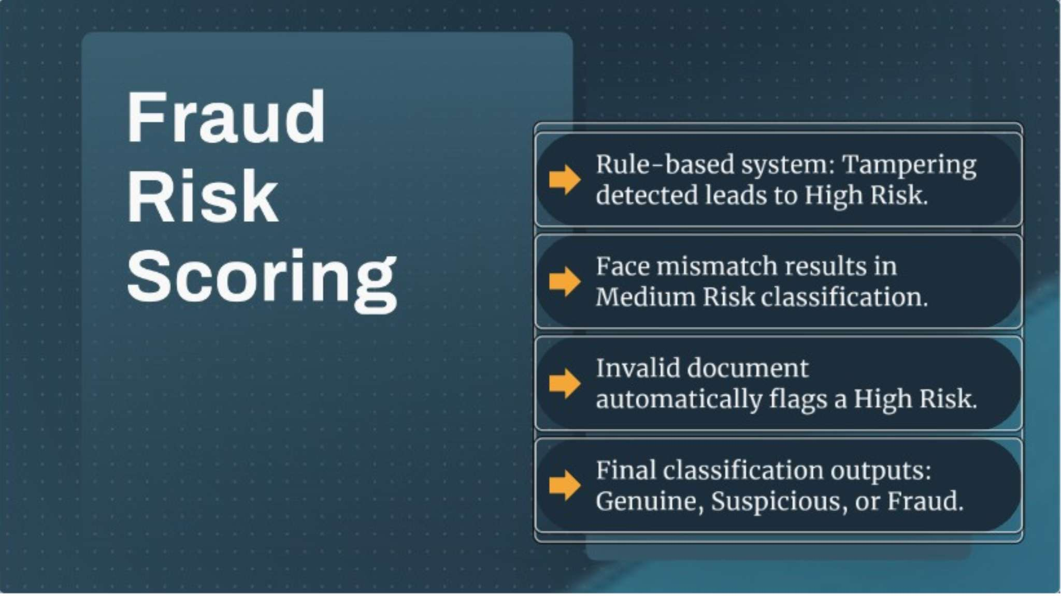

Slide 9
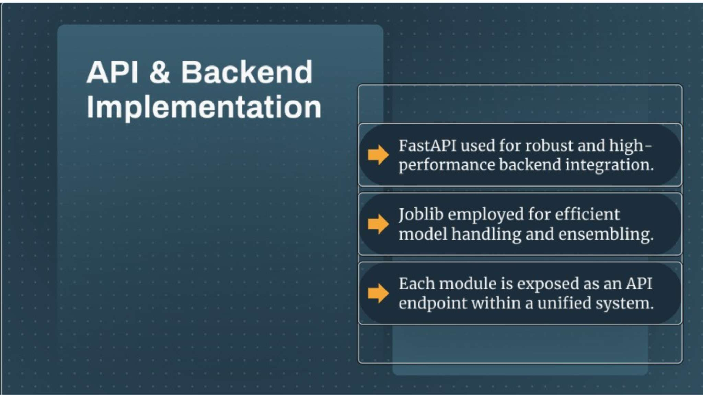
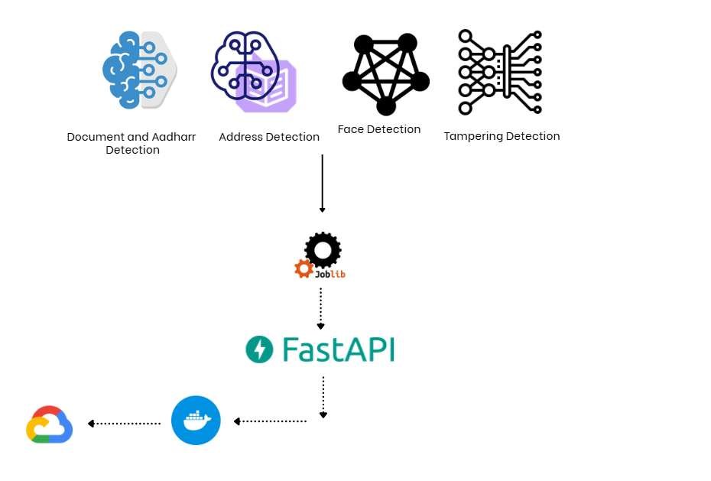

Slide 10



Slide 11
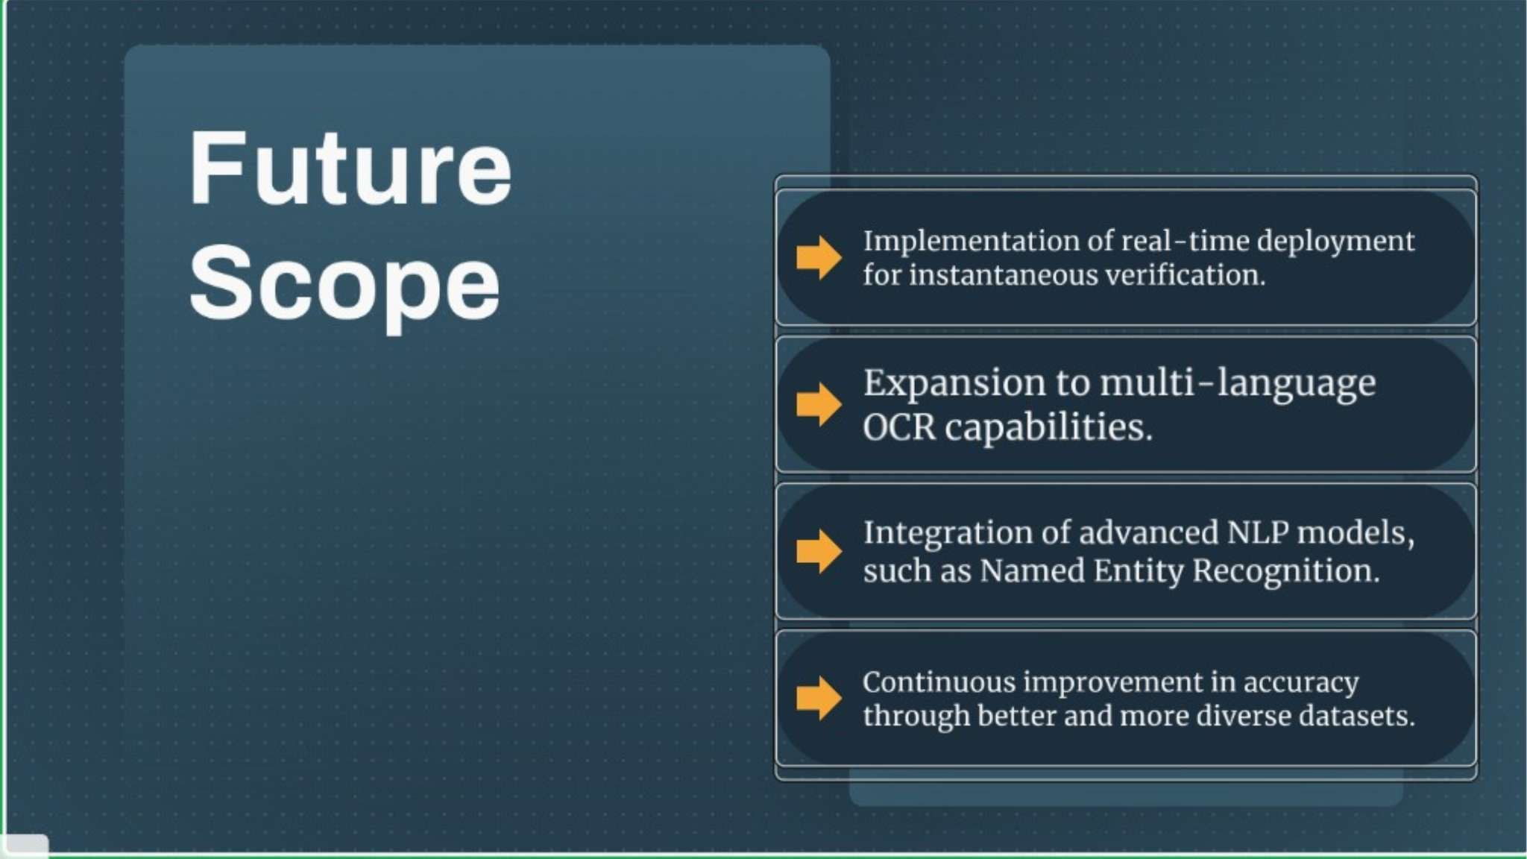

Slide 12
